Slide 1
Channel Coding

Slide 2
Channel Coding
Why?
To increase the resistance of digital communication systems to channel noise via error control coding
How?
By mapping the incoming data sequence into a channel input sequence and inverse mapping the channel output sequence into an output data sequence in such a way that the overall effect of channel noise on the system is minimised
Redundancy is introduced in the channel encoder so as to reconstruct the original source sequence as accurately as possible.

Slide 3
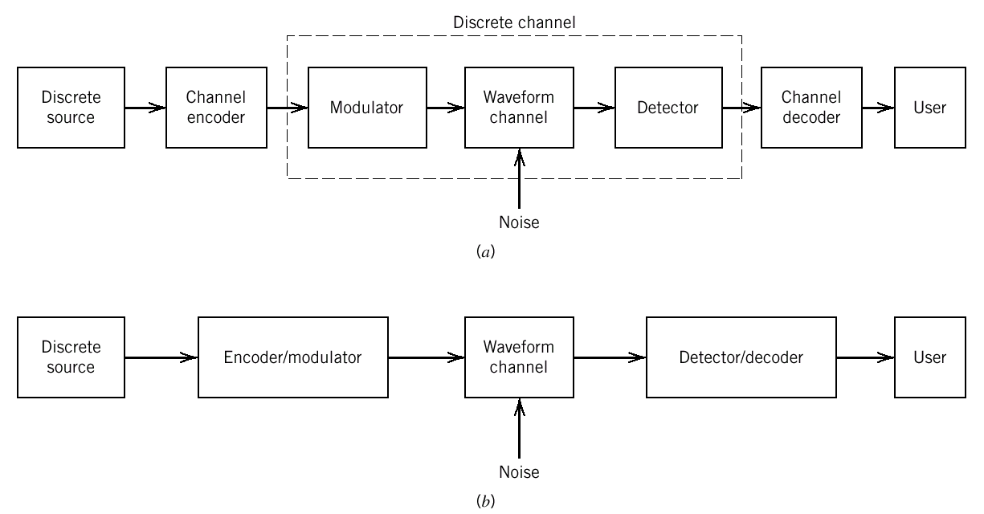
Error Control Coding
Error control for data integrity may be exercised by means of forward error correction (FEC).
The discrete source generates information in the form of binary symbols.
The channel encoder accepts message bits and adds redundancy to produce encoded data at higher bit rate.
The channel decoder uses the redundancy to decide which message bits were actually transmitted.
What is the implication?

Slide 4
The implication of Error Control Coding
Addition of redundancy implies the need for increased transmission bandwidth
It also adds complexity in the decoding operation
Therefore, there is a design trade-off in the use of error-control coding to achieve acceptable error performance considering bandwidth and system complexity.
Types of Error Control Coding
  Block codes
  Convolutional codes

Slide 5
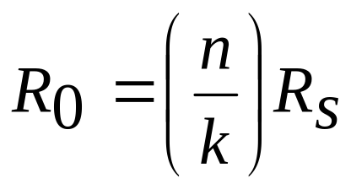
Block Codes
Usually in the form of (n,k) block code where n is the number of bits of the codeword and k is the number of bits for the binary message
To generate an (n,k) block code, the channel encoder accepts information in successive k-bit blocks
For each block add (n-k) redundant bits to produce an encoded block of n-bits called a code-word
The (n-k) redundant bits are algebraically related to the k message bits
The channel encoder produces bits at a rate called the channel data rate, R₀
Where R_{s} is the bit rate of
the information source
and n/k is the code rate

Slide 6
Forward Error-Correction (FEC)
The channel encoder accepts information in successive k-bit blocks and for each block it adds (n-k) redundant bits to produce an encoded block of n-bits called a code-word.
The channel decoder uses the redundancy to decide which message bits were actually transmitted.
In this case, whether the decoding of the received code word is successful or not, the receiver does not perform further processing.
In other words, if an error is detected in a transmitted code word, the receiver does not request for retransmission of the corrupted code word.
Automatic-Repeat Request (ARQ) scheme
Upon detection of error, the receiver requests a repeat transmission of the corrupted code word
There are 3 types of ARQ scheme
    Stop-and-Wait
    Continuous ARQ with pullback
    Continuous ARQ with selective repeat

Slide 7
Types of ARQ scheme
Stop-and-wait
A block of message is encoded into a code word and transmitted
The transmitter stops and waits for feedback from the receiver either an acknowledgement of a correct receipt of the codeword or a retransmission request due to error in decoding.
The transmitter resends the code word before moving onto the next block of message
What is the implication of this?
Idle time during stop-and-wait is wasted and will reduce the data throughput
Any idea to overcome this?

Slide 8
Types of ARQ scheme
Continuous ARQ with pullback (or go-back-N)
Allows the receiver to send a feedback signal while the transmitter is sending another code word
The transmitter continues to send a succession of code words until it receives a retransmission request.
It then stops and pulls back to the particular code word that was not correctly decoded and retransmits the complete sequence of code words starting with the corrupted one.
What is the implication of this?
Code words that are successfully decoded are also retransmitted. This is a waste of resources
Any idea to overcome this?

Slide 9
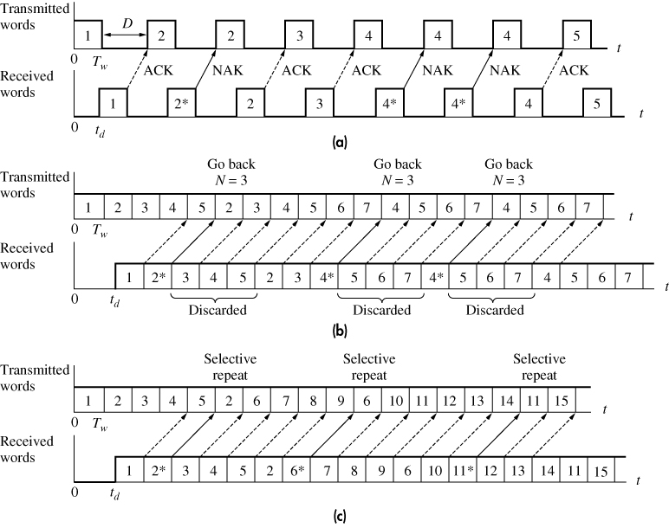
Continuous ARQ with selective repeat
Retransmits the code word that was incorrectly decoded only.
Thus, eliminates the need for retransmitting the successfully decoded code words.
ARQ schemes (a) stop-and-wait (b) go-back (c) selective repeat
Figure 13.1-7

Slide 10
Linear Block Codes
An (n,k) block code indicates that the codeword has n number of bits and k is the number of bits for the original binary message
A code is said to be linear if any two code words in the code can be added in modulo-2 arithmetic to produce a third code word in the code
Code Vectors
Any n-bit code word can be visualised in an n-dimensional space as a vector whose elements having coordinates equal the bits in the code word
For example a code word 101 can be written in a row vector notation as (1 0 1)
Matrix representation of block codes
The code vector can be written in matrix form:
A block of k message bits can be written in the form of 1-by-k matrix
  Modulo-2 operations
  The encoding and decoding functions involve the binary arithmetic operation of modulo-2
  Rules for modulo-2 operations are…..

Slide 11
Modulo-2 operations
  The encoding and decoding functions involve the binary arithmetic operation of modulo-2
  Rules for modulo-2 operations are:
      Modulo-2 addition
      0 + 0 = 0
      1 + 0 = 1
      0 + 1 = 1
      1 + 1 = 0
      Modulo-2 multiplication
      0 x 0 = 0
      1 x 0 = 0
      0 x 1 = 0
      1 x 1 = 1

Slide 12
Linear Block Code – Example : The Repetition Code
The additional (redundancy) bits (n-k) are identical to k
Example : A (5,1) repetition code.
The original binary message has 1 bit. (5-1=4) bits are added to the binary message to form a code word and the 4 additional bits are identical to the 1 bit binary message.
So, you have 2 code words either 11111 or 00000.
In the case of error, 1 will changed to 0 and/or vice versa and the decoder will know that it has wrongly received a code word.

Slide 13
Parity-check Codes
Codes are based on the notion of parity.
The parity of a binary word is said to be even when the word contains and even number of 1s and odd parity when it has odd number of 1s.
A group of n-bits codewords are constructed from a group of n-1 message bits.
One check bit is added to the n-1 message bits such that all the codewords have the same parity
When the received codeword has different parity, we know that an error has occurred
Example : n=3 and even parity
The binary message are 00,01,10,11
The check bit is added such that all the code words have even parity
So, the resulting code words are 000,011,101 and 110

Slide 14
Systematic Block Codes
Codes in which the message bits are transmitted in an unaltered form.
Example : Consider an (n,k) linear block code
There are 2^{k} number of distinct message blocks and 2^{n} number of distinct code words
Let m₀,m₁,….m_{k-1} constitute a block of k-bits binary message
By applying this sequence of message bits to a linear block encoder, it adds n-k bits to the binary message
Let b₀,b₁,….b_{n-k-1} constitute a block of n-k-bits redundancy
This will produce an n-bits code word
Let c₀,c₁,….c_{n-1} constitute a block of n-bits code word
Using vector representation they can be written in a row vector notation respectively as
(c₀ c₁ …. c_{n} ) , (m₀ m₁ …. m_{k-1} ) and (b₀ b₁ …. b_{n-k-1} )

Slide 15
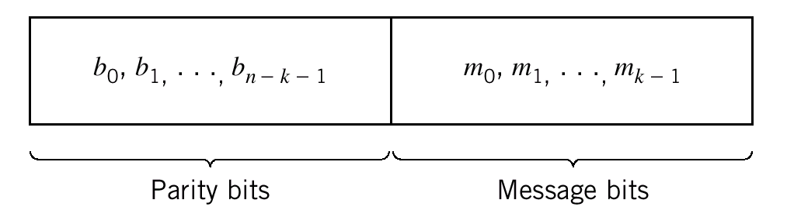
Systematic Block Codes
Using matrix representation, we can define
c, the 1-by-n code vector = [c₀ c₁ …. c_{n} ]
m, the 1-by-k message vector =[m₀ m₁ …. m_{k-1} ]
b, the 1-by-(n-k) parity vector = [b₀ b₁ …. b_{n-k-1} ]
With a systematic structure, a code word is divided into 2 parts. 1 part occupied by the binary message only and the other part by the redundant (parity) bits.
The (n-k) left-most bits of a code word are identical to the corresponding parity bits
The k right-most bits of a code word are identical to the corresponding message bits

Slide 16
Systematic Block Codes
In matrix form, we can write the code vector,c as a partitioned row vector in terms of vectors m and b
c=[b m]
Given a message vector m, the corresponding code vector, c for a systematic linear (n,k) block code can be obtained by a matrix multiplication
c=m.G
Where G is the k-by-n generator matrix.

Slide 17
Systematic Block Codes – The generator matrix, G
G, the k-by-n generator matrix has the general structure
G = [I_{k} P]
Where I_{k} is the k-by-k identity matrix and
P is the k-by-(n-k) coefficient matrix
1 | 0 | …. | 0
0 | 1 | …. | 0
0 | 0 | …. | 1
P₀₀ | P₀₁ | ….. | P_{0,n-k-1}
P₁₀ | P₁₁ | ….. | P_{1,n-k-1}
P_{k-1, 0} | P_{k-1,1} | ….. | P_{k-1,n-k-1}
I_{k}=
P =
The identity matrix simply reproduces the message vector for the first
k elements of c
The coefficient matrix generates the parity vector,b via b=m.P
The elements of P are found via research on coding.

Slide 18
Hamming Code
A type of (n, k) linear block codes with the following parameters
    Block length, n = 2^{m} - 1
    Number of message bits, k = 2^{m} – m -1
    Number of parity bits : n-k=m
    m >= 3

Slide 19
  Hamming Code – Example
A (7,4) Hamming code with the following parameters
  n=7; k=4, m=7-4=3
  The k-by-(n-k) (4-by-3) coefficient matrix, P =
  The generator matrix, G is, G =
1 | 1 | 0
0 | 1 | 1
1 | 1 | 1
1 | 0 | 1
P =
1 | 1 | 0 | 1 | 0 | 0 | 0
0 | 1 | 1 | 0 | 1 | 0 | 0
1 | 1 | 1 | 0 | 0 | 1 | 0
1 | 0 | 1 | 0 | 0 | 0 | 1
G =

Slide 20
  Hamming Code – Example
  The parity vector,b is generated by b=m.P
  For a given block of message bits m = (m1 m2 m3 m4), we can work out the parity vector, b and hence the code word, c = mG for the (7,4) Hamming Code.
  Exercise: Try to work out the codewords for the (7,4) Hamming Code.

Slide 21
Codewords for (7,4) Hamming Code
Message Word | Parity bits | Code words
0000 | 000 | 0000000
0001 | 101 | 1010001
0010 | 111 | 1110010
0011 | 010 | 0100011
0100 | 011 | 0110100
0101 | 110 | 1100101
0110 | 100 | 1000110
0111 | 001 | 0010111
1000 | 110 | 1101000
1001 | 011 | 0111001
1010 | 001 | 0011010
1011 | 100 | 1001011
1100 | 101 | 1011100
1101 | 000 | 0001101
1110 | 010 | 0101110
1111 | 111 | 1111111

Slide 22
  Cyclic Codes
  A subclass of linear codes having a cyclic structure.
  The code vector can be expressed in the form
  c = ( c_{n-1} c_{n-2} ……c₁ c₀ )
  A new code vector in the code can be produced by cyclic shifting of another code vector.
  For example, a cyclic shift of all n bits one position to the left gives
  c’ = ( c_{n-2} c_{n-3} ……c₁ c₀ c_{n-1})
  A second shift produces another code vector, c”
  c” = ( c_{n-3} c_{n-4} ……c₁ c₀ c_{n-1} c_{n-2})

Slide 23
  Cyclic Codes
  The cyclic property can be treated mathematically by associating a code vector, c with the code polynomial, c(X)
  c(X) = c₀ + c₁X + c₂X²+……c_{n-1}X^{n-1}
  The power of X denotes the positions of the codeword bits.
  The coefficients are either 1s and 0s.
  An (n,k) cyclic code is defined by a generator polynomial, g(X)
  g(X) = X^{n-k} + g_{n-k-1}X^{n-k-1} + ……. + g₁X + 1
  The coefficient g are such that g(X) is a factor of X^{n} + 1

Slide 24
  Cyclic Codes – Encoding Procedure
  To encode an (n,k) cyclic code
  Multiply the message polynomial , m(X) by X^{n-k}
  Divide X^{n-k}.m(X) by the generator polynomial, g(X) to obtain the remainder polynomial, b(X)
  3. Add b(X) to X^{n-k.}m(X) to obtain the code polynomial

Slide 25
  Cyclic Codes - Example
  The (7,4) Hamming Code
  For message sequence 1001
  The message polynomial, m(X) = 1 + X³
  1. Multiply by X^{n-k} (X³) gives X³ + X⁶
  2. Divide by the generator polynomial, g(X) that is a factor of X^{n} + 1
  For the (7,4) Hamming code is defined by its generator polynomials, g(X) that are factors of X⁷ + 1
  With n =7, we can factorize X⁷ + 1 into three irreducible polynomials
  X⁷ + 1 = (1 + X)(1 + X² + X³)(1 + X + X³)

Slide 26
  Cyclic Codes - Example
  For example we choose the generator polynomial, 1 + X + X³ and perform the division we get the remainder, b(X) as X² + X
  3. Add b(X) to obtain the code polynomial, c(X)
  c(X) = X + X² + X³ + X⁶
  So the codeword for message sequence 1001 is 0111001

Slide 27
  Cyclic Codes – Exercise
  Find the codeword for (7,4) cyclic Hamming Code using the generator polynomial, 1 + X + X³ for the message sequence 0011

Slide 28
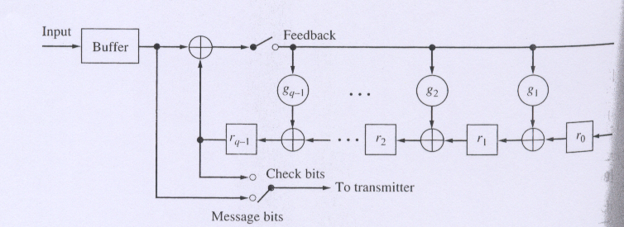
  Cyclic Codes – Implementation
  The Cyclic code is implemented by the shift-register encoder with (n-k) stages
r_{n-k-1}
  Encoding starts with the feedback switch closed, the output switch in the message bit position, and the register initialised to the all-zero state.
  The k message bits are shifted into the register and delivered to the transmitter.
  After k shift cycles, the register contains the b check bits.
  The feedback switch is now opened and the output switch is moved to the check bits to deliver them to the transmitter.

Slide 29
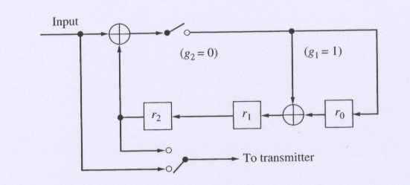
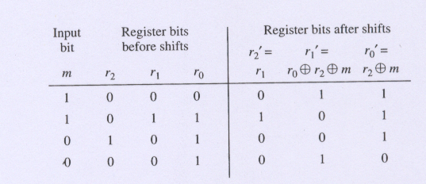
  Cyclic Codes – Implementation example
  The shift-register encoder for the (7,4) Hamming Code has (7-4=3) stages
When the input message is 0011, after 4 shift cycles the redundancy bits are delivered

Slide 30
  Cyclic Codes – Implementation Exercise
  The shift-register encoder for the (7,4) Hamming Code has (7-4=3) stages
When the input message is 1001, after 4 shift cycles the redundancy bits are delivered
1
The check bits
is 011
0
0
0
0
1
1
0
0
1
1
1
1
0
0
1
1
0
1
1
1
1
1
1
1
1
1
0

Slide 31
  Cyclic Codes – Implementation Exercise
  The shift-register encoder for the (7,4) Hamming Code has (7-4=3) stages
When the input message is 1100?

Slide 32
Code parameters
The Hamming distance
  The Hamming distance between a pair of code vectors, c1 and c2 that have the same number of elements is defined as the number of locations in which their respective elements differ
The Hamming weight
  The Hamming weight of a code vector c is defined as the number of nonzero elements in that code vector
  Equivalent to the distance between a code vector and an all-zero code vector
The minimum distance
  The minimum distance of a linear block code is defined as the smallest Hamming distance between any pair of code vectors in the code.
  Equivalent to the smallest Hamming weight of the difference between any pair of code vectors
  Equivalent to the smallest Hamming weight of the nonzero code vectors in the code
Code rate
  The ratio between the number of original message bits and the number of bits of the codeword
  For (n,k) code , code rate = k/n.

Slide 33
Codewords for (7,4) Hamming Code
Message Word | Parity bits | Code words | Hamming weight
0000 | 000 | 0000000
0001 | 101 | 1010001
0010 | 111 | 1110010
0011 | 010 | 0100011
0100 | 011 | 0110100
0101 | 110 | 1100101
0110 | 100 | 1000110
0111 | 001 | 0010111
1000 | 110 | 1101000
1001 | 011 | 0111001
1010 | 001 | 0011010
1011 | 100 | 1001011
1100 | 101 | 1011100
1101 | 000 | 0001101
1110 | 010 | 0101110
1111 | 111 | 1111111
Min dist=?

Slide 34
Code parameters
The minimum distance of a code determines the error detecting and correcting capability of the code
Error detection is always possible when the number of transmission errors in a codeword is less than the minimum distance so that the erroneous word may not be seen as another valid code vector
Various degrees of error control capability
  Detect up to l errors per word , dmin >= l + 1
  Correct up to t errors per word, dmin >= 2t + 1
  Correct up to t errors and detect l > t errors per word,
  dmin >= t + l + 1
Code rate is a measure of the code efficiency

Slide 35
